Slide 1
Learn to speak "Agile"
Joel Robinson
Joelhrobinson@gmail.com
Increase your professional vocabulary with terms like:
Green & Brown Fields, Fish-bones, T-Shirt Sizing, Poker, Grooming, Burn Up, Burn Down, "Chickens and Pigs"

Slide 2
We all have different Vocabularies.
Buenos días Bonjour
صباح الخير (Sabah Alkhyr) Selamat Pagi
Guten Morgen Günaydın
Καλημέρα (Kaliméra) 早上好 (Zǎoshang hǎo)
शुभ प्रभात (shubh prabhaat) Доброе утро (Dobroye utro)
Habari za asubuhi
Chào buổi sáng
காலை வணக்கம் (Kālai vaṇakkam)
おはようございます (Ohayōgozaimasu)

Slide 3
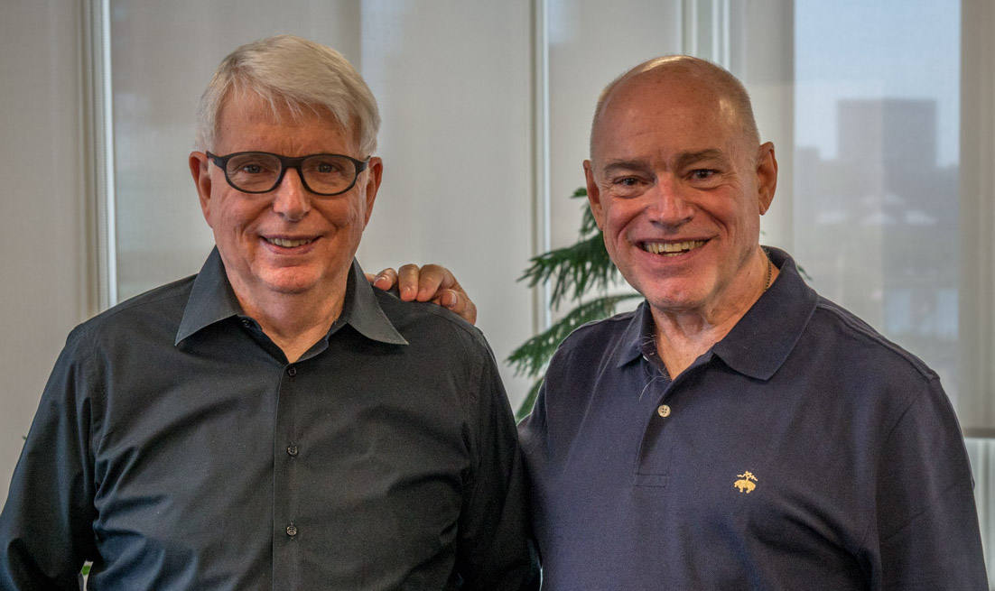

Agile invented in 2001
Jeff Sutherland
Ken Schwaber

Slide 4
What is Agile
Agile is a set of values and principles, a set of beliefs to use while developing software.
Not a methodology
Not a set of tools
Not a framework or process
Not a specific way of developing software

Slide 5
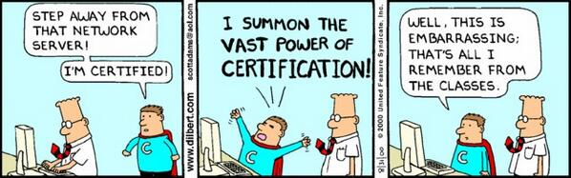
Anyone here Agile / Scrum certified?

Slide 6
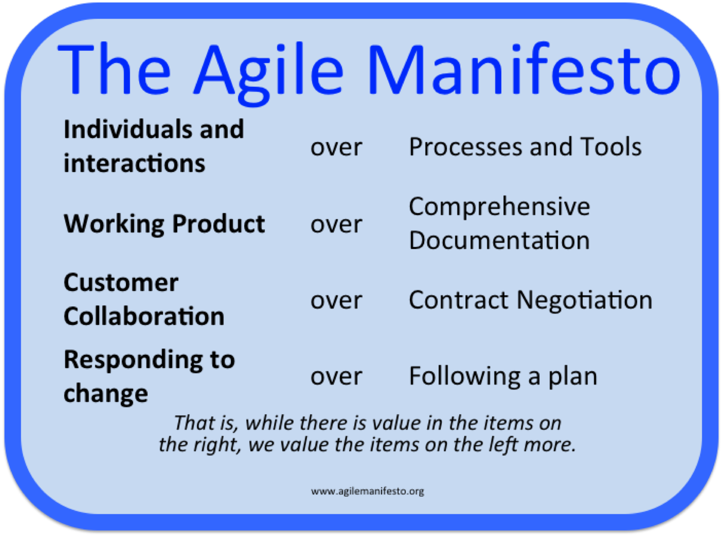
We can develop software better when we value the items on the left more than on the right.

Slide 7
Agile is both Iterative and Incremental
An iterative process is one that makes progress through successive refinement. You make a first try. It’s incomplete, not pretty. then
You show it to the customer. Is this what you had in mind?
And the next time you crawl a little closer to a satisfactory product, more features, details.

Slide 8
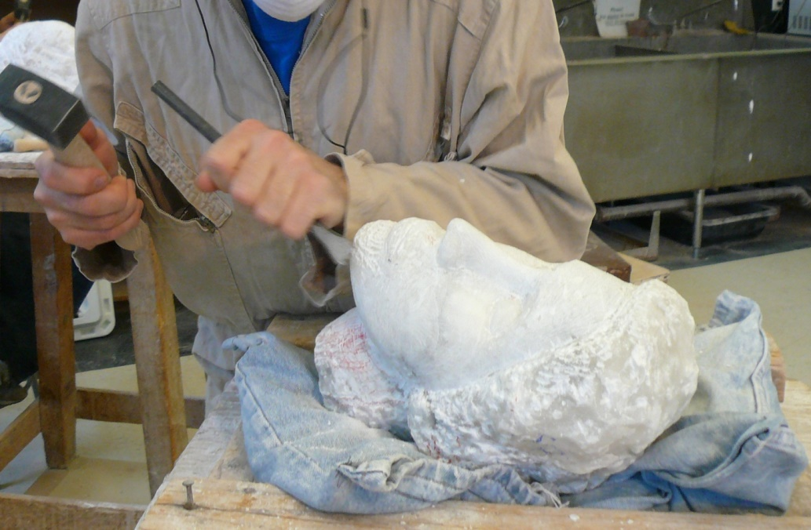
Agile is both Iterative and Incremental
An iterative process is one that makes progress through successive refinement. You make a first try. It’s incomplete, not pretty.
You show it to the customer. Is this what you had in mind?

Slide 9
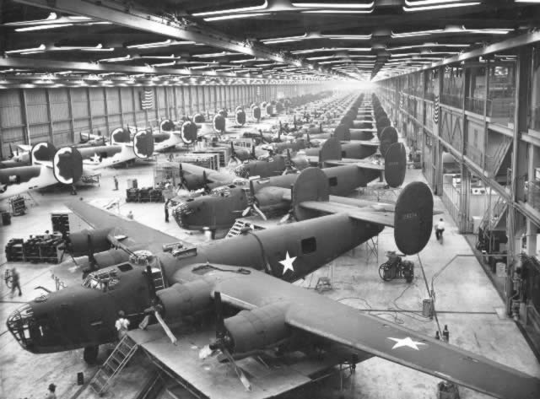
Agile is both Iterative and Incremental
An incremental process is one in which software is built and delivered in pieces. Each piece, or increment, represents a complete subset of functionality.
Each increment is fully coded and tested, and the common expectation is that the work of an iteration will not need to be revisited. www.mountaingoatsoftware.com

Slide 10
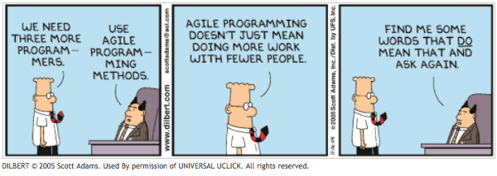
Agile doesn’t mean working with fewer people, it means developing products that better please the customer and better meet their needs.

Slide 11
Agile software development
Agile software development describes an approach in which requirements and solutions evolve through the collaborative effort of self-organizing and cross-functional teams and their customers & end users.
Agile advocates adaptive planning, evolutionary development, early delivery, and continual improvement, and it encourages rapid and flexible responses to change.
Agile approaches are iterative and incremental.

Slide 12
#3 Agile Events
Release Planning A high level plan for multiple sprints to reach release goals
Sprint Planning a collaborative effort of the scrum team (scrum master, product owner and dev team) to define the work and effort of the coming sprint.

Slide 13
#3 Agile Events (2)
Sprint: a time-boxed period of a development
Sprint Demo: a demonstration of development to stakeholders and management to elicit feedback
Sprint Retrospective: a process improvement meeting

Slide 14
Starting The Project
Project Vision Why are we doing this project and who will benefit?
Project Charter What are we going to do? Who is going to do it? What is the definition of success? How will we do it?
Identify stakeholders Interested parties, customers, interacting organizations,

Slide 15
Standup Scrum Meeting
The Team meets for 15 minutes, usually standing, hopefully in the same room, but probably not.
Everyone takes a turn with three questions:
1. What did I do since we last met?
2. What am I going to do today?
3. Do I have any impediments that are keeping me from doing my work.

Slide 16
Standup Scrum Meeting
Meet same place, same time every day or scheduled day
Every team member is expected to speak.
Only team members (developers, test, etc. ) are supposed to talk.
Managers should observe silently, and save their questions for later.
Otherwise the time will drag on and on.

Slide 17
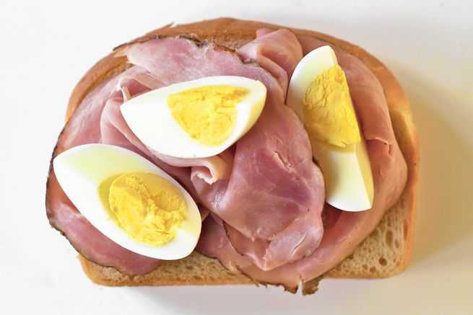

Slide 18
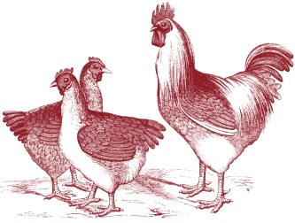
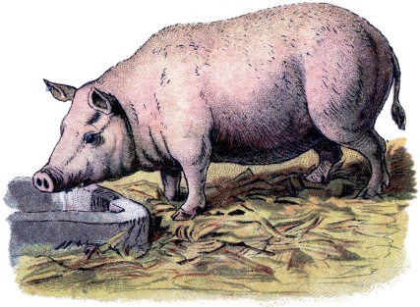
Talking Chickens and Missing Pigs
This example comes from Mike Cohn, Agile blogger and author. Chickens are those outside the development team. Like providers of a bacon and eggs menu, they are interested in the project but offering an “egg”, but their own “bacon” is not at stake.
Pigs are those inside the development team. Like providers of a bacon and eggs menu, their own “bacon” is on the line.

Slide 19
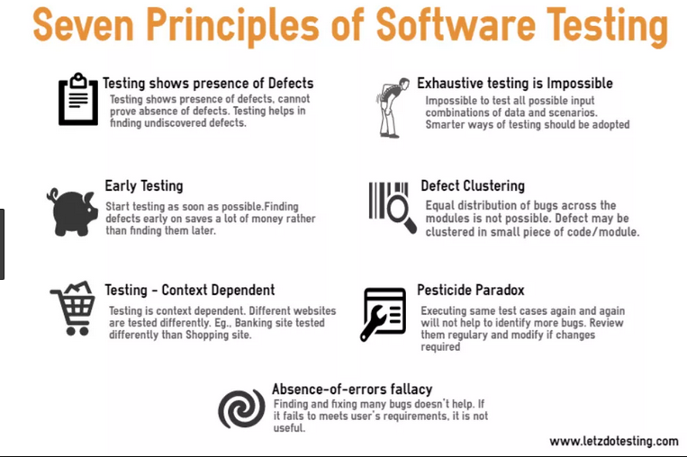

Slide 22
2. Defect Clustering
Defect Clustering: a small number of modules contain most of the defects detected.
This is the application of the Pareto Principle to software testing: approximately 80% of the problems are found in 20% of the modules.
Spend your time predicting where defects are likely to be.
For that you need to consult Pythia, the high priestess of Apollo
from Delphi, Greece.
www.istqb.org

Slide 23
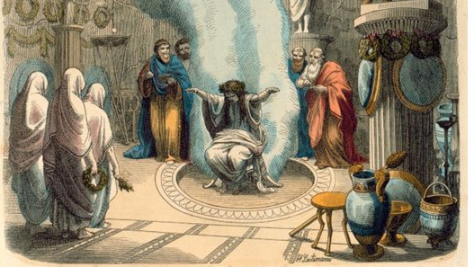

Slide 24
3. Pesticide Paradox
Repetitive use of the same pesticide mix to eradicate insects leads to the insects developing resistance to the pesticide.
The same applies to software testing. If the same set of repetitive tests are conducted, the method will be useless for discovering new defects.

Slide 25

Pesticide Paradox Drawing by Joel Montvelisky, https://qablog.practitest.com

Slide 26
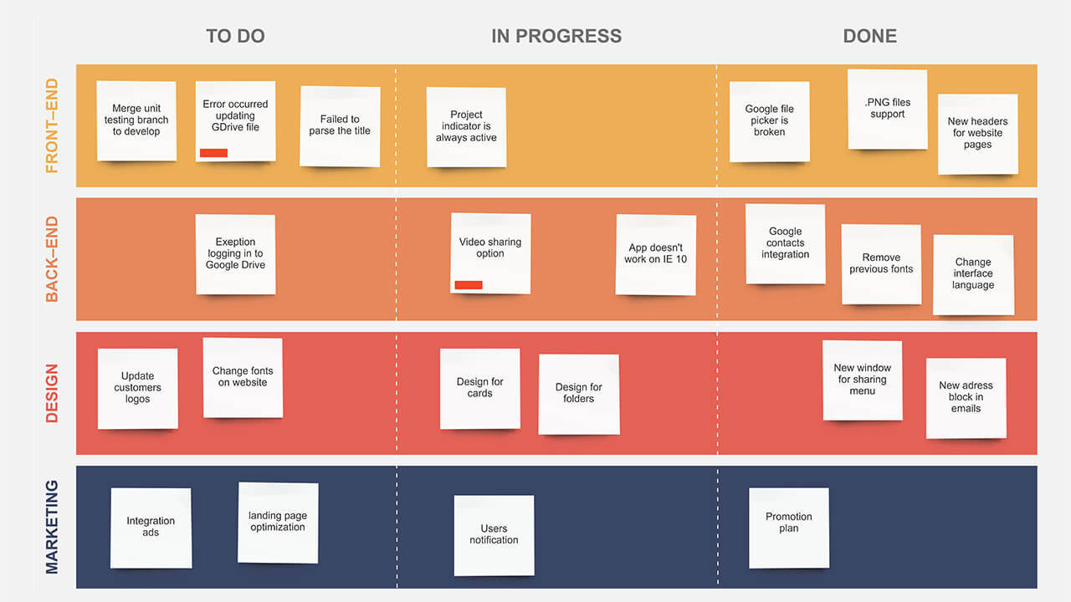

Slide 27
Scrum “Smell” Origins
In his book Refactoring, (1999) Martin Fowler introduced the term smell to refer to an uneasy feeling that something that may not be right.
According to Charles Bradley these are symptoms 'that possibly indicates a deeper problem. It doesn't always mean the bad smell is indicative of a true problem, but most times it is" [Charles Bradley].Aug 21, 2015

Slide 28
Product Owner Overreach
When product owners jump in and assign tasks and stories to individual dev team members it may be a “Smell”.
Scrum Dev teams should be self-managed. No one outside the team directs the team. This can be a difficult learning experience for project management teams moving to agile.

Slide 29
Organization Managerial Overreach
Upper management may feel compelled to ‘help out’ by reassigning team members among scrum teams and rearranging priorities mid-iteration to fit ‘special cases’. This is a smell.
It is important that Scrum Dev teams are purposely empowered by organization management to be self-managed. Teams need to remain intact during a sprint to do their job. Leave them alone.

Slide 30
What is Agile
Agile is a set of values and principles, a set of beliefs to use while developing software.
Not a methodology
Not a set of tools
Not a framework or process
Not a specific way of developing software

Slide 31
Lean

Slide 32
T-Shirt Sizing: A relative estimation technique which uses qualitative measures rather than quantitative ones to assert the projected size of backlog items. Typical sizes include XS, S, M, L, XL, and XXL. The use of T-Shirt sizing may make the elicitation of metrics, such as a burn-down chart, difficult unless they are mapped to a numerical scheme such as story points. See also: relative estimation.

Slide 33
Three Questions: The planning considerations which each member of a Scrum Development Team must elicit during a Daily Scrum: namely, what they did yesterday to help the team meet the Sprint Goal, what they intend to do today to help meet that goal, and any impediments to their doing so

Slide 34
Brown Field vs. Green Field

Slide 35
Kanban a method of managing products/tasks with emphasis on continual delivery while limiting work in progress. Japanese for Bulletin board

Slide 36
Extreme Programming a SW development methodology pair programming, avoiding unnecessary work, frequent releases, and constant customer contact.

Slide 38
Kanban Issues
A Kanban board is a physical / electronic display of tasks moving through the development team.
Prioritized tasks are taken from a to-do list and worked on until complete. There is not sprint.
Only a certain number of tasks can be in any given state

Slide 39
Product Backlog
Product owner works with customer to create a product backlog.
Epics are decomposed to stories, stories into sprint items.
User Stories As user ___ I want to ___ so that ___ benefit__
Items should be detailed, emergent (current) estimated, and prioritized. [DEEP]
Items should be Independent of other items, negotiated with the customer, valuable to the customer, estimated, small, and testable. [INVEST]

Slide 40
Chaos Monkey

Slide 41
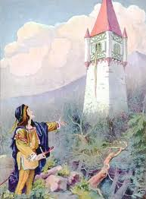


Where are you? Island? Tower? Silo?

Slide 42
Kaizan Fishbone Tagucci

Slide 43
Oracle Testing

Slide 44
Wide Band Delphi Estimating

Slide 45
QUIZ: Incremental vs. Iterative

Slide 46
Continuous deployment vs continuous Delivery
Continuous deployment – Manual deployment to production (often)
Continuous Delivery – Automated deployment to production

Slide 47
Definition of Done

Slide 48
Kanban vs Scrum

Slide 49
http://www.kanban101.com/what-is-kanban/
What is Kanban?
Kanban is a lean agile system that can be used to enhance any software development lifecycle including Scrum, XP, or Waterfall. It is NOT EXCLUSIVE.
Its goal is the efficient delivery of finished tasks
Kanban promotes the lean concept of flow
to continuously and predictably deliver value.
The work and the workflow is made visible
to make activities and issues like backups obvious.
Kanban limits work in progress to promote focus and finishing, and indirectly, quality

Slide 51
Why limit the WIP?
Limiting WIP Rules:
Product cycle time is how long it takes a work item to flow to completion.
Limiting WIP will reduce overall cycle time.
The chosen work is always the highest priority of any group.
Queues start backing up immediately at any blockage.
A blockage anywhere slows down the entire system
Blockages are resolved by reallocating resources to fix the problem
Limiting WIP reduces complexity of tasks (less switching)
Limiting WIP reduces lead times and increases quality
Quality is increased due to earlier addressing of issues
David Joyce on what happens when blocks occur in a limited workflow

Slide 52
Pull: The demand exerted by consumers of value for completed work, and which encourages development teams to release usable increments at a sustainable pace and which maximizes the value delivered.

Slide 53
Planning Poker:
A relative estimation technique using playing cards enumerated with a Fibonacci-like sequence. Each member of the Development Team will get a set of cards, and will use them to indicate the relative size of the backlog items being considered. See also: product backlog refinement.

Slide 54
Kanban:
A closed economy of production in which work in progress is represented by a finite number of tokens, and the delivery of value is optimized by inspection, adaptation, and the ongoing reduction of waste.

Slide 55
Kaizen:
Improvement, usually taken to mean improvement in a gradual sense by means of empiricism, transparency, inspection, and adaptation.

Slide 56
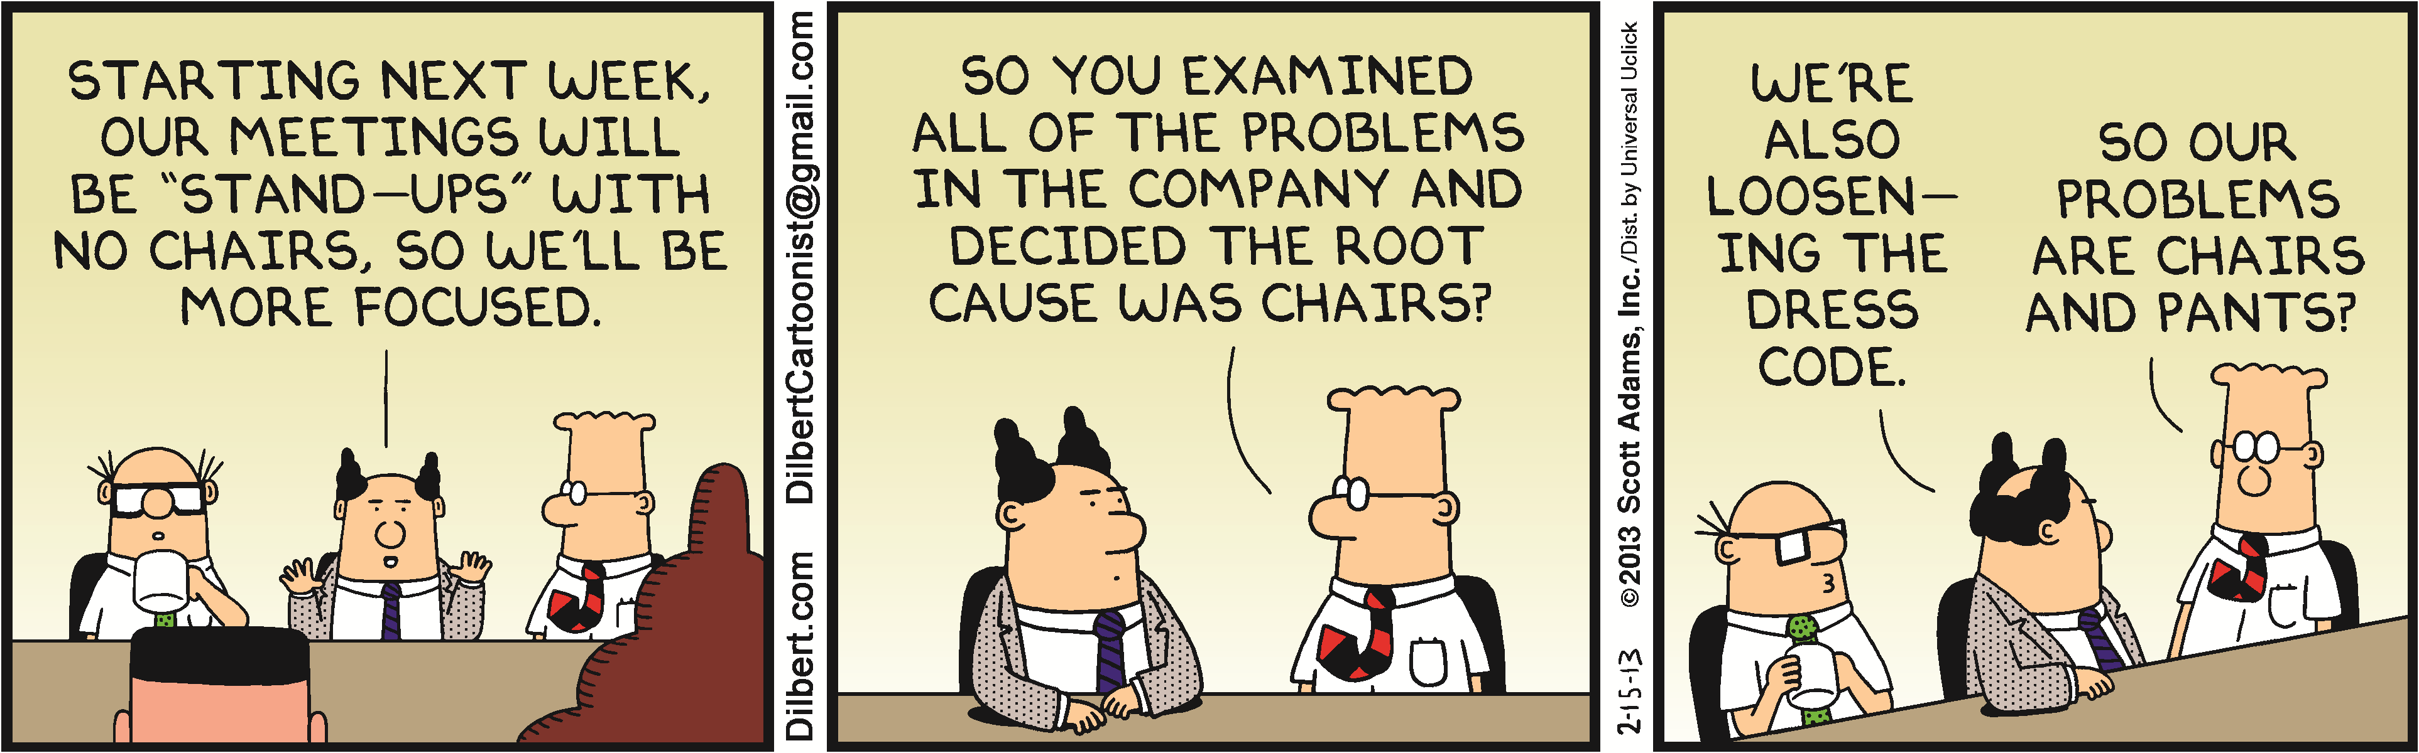
Stand-Up

Slide 58
Organization Managerial Overreach
Upper management may feel compelled to ‘help out’ by reassigning team members among scrum teams and rearranging priorities mid-iteration to fit ‘special cases’. This is a smell.
It is important that Scrum Dev teams are purposely empowered by organization management to be self-managed. Teams need to remain intact during a sprint to do their job. Leave them alone.

Slide 59
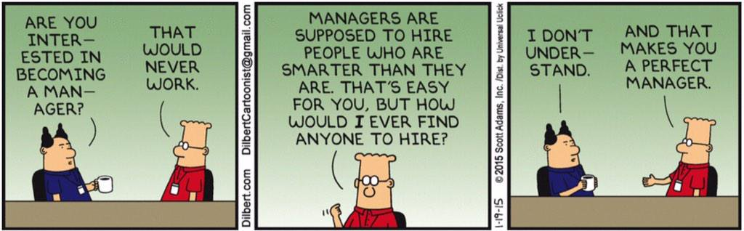
Manager

Slide 60
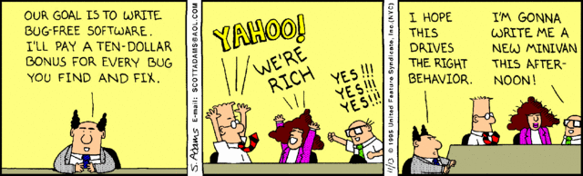
Metrics

Slide 61
Burn-Up Chart
A chart which shows the amount of work which has been completed. Time is shown on the horizontal axis and work completed on the vertical axis. As time progresses and items are drawn from the backlog and completed, a plot line showing the work done may be expected to rise. The amount of work may be assessed in any of several ways such as user story points or task hours. The amount of work considered to be in-scope may also be plotted as a line; the burn-up can be expected to approach this line as work is completed.

Slide 62
Burn-Down Chart
A chart which shows the amount of work which is thought to remain in a backlog. Time is shown on the horizontal axis and work remaining on the vertical axis. As time progresses and items are drawn from the backlog and completed, a plot line showing work remaining may be expected to fall. The amount of work may be assessed in any of several ways such as user story points or task hours. Work remaining in Sprint Backlogs and Product Backlogs may be communicated by means of a burn-down chart

Slide 63
INVEST Criteria:
The qualities of a user story or similar item of inventory which make it independent of other items, negotiable as an element of scope, valuable to stakeholders, estimable by those doing the corresponding work, small enough to be completed by them in a timely manner, and testable in order to prove its fitness for release.

Slide 64
Fail Early:
The elimination of future waste by calling a halt to an initiative which has failed to demonstrate empirical value, and before any further waste is allowed to accumulate.

Slide 65
Information Radiator:
A mechanism through which timely and useful information can be pulled on-demand by interested observers, and relied on for its transparency and accuracy. The most common type of information radiator found in agile practice is a Scrum Board or Kanban Board.

Slide 66
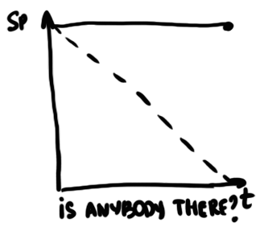

Slide 67
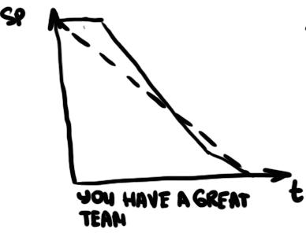

Slide 68
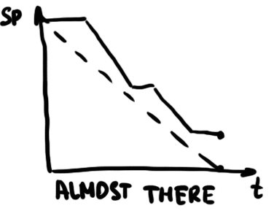

Slide 69
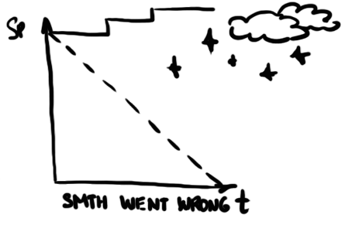
Metrics Burn down chart

Slide 70
Verify vs. Validate

Slide 71
Ronald Reagan trust but Verify
https://www.youtube.com/watch?v=As6y5eI01XE

Slide 72
Do you understand the words that are coming out of my mouth?
https://www.youtube.com/watch?v=0Rl9Cxc7uZA

Slide 73
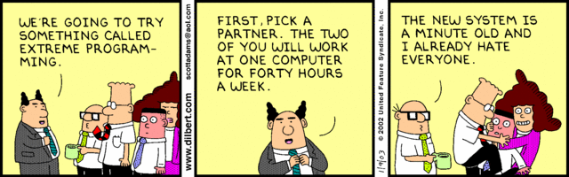

Slide 74
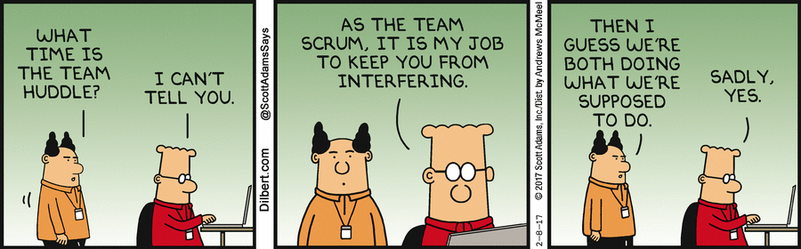

Slide 75
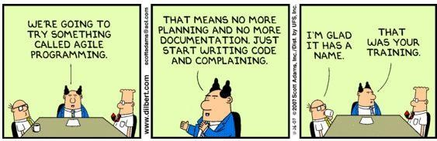

Slide 76
Bad sh*t scrum masters say
https://www.barryovereem.com/scrum-master-misunderstandings/

Slide 77
